Slide 1

Introduction to
Johannes Blaschke, LBNL, USA
SC24, Atlanta

Slide 2
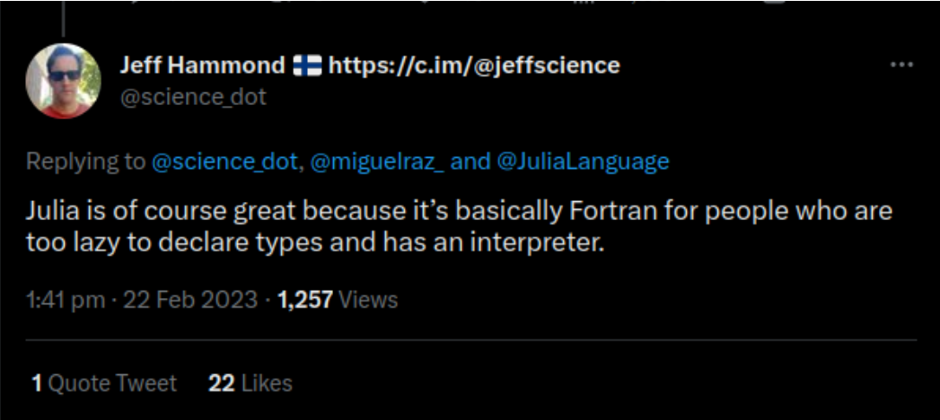
Julia and HPC

Slide 3





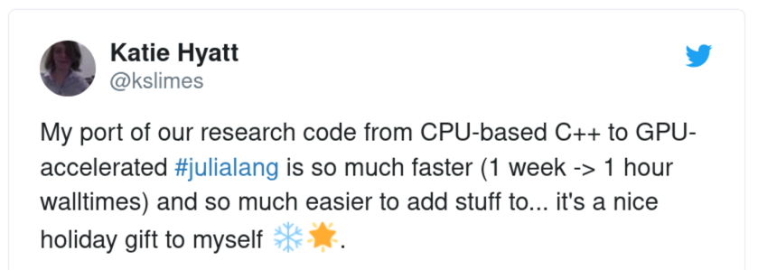




Why Julia for HPC? Walks like Python, talks like Lisp, runs like Fortran
Rich GPU Ecosystem
HPC suffers from the many language problem;
Domain experts and performance engineers use
different programming languages:
Communication and Collaboration bottleneck
https://www.nature.com/articles/d41586-019-02310-3
AST
xPU back end
IR
Metal.jl
oneAPI.jl
CUDA.jl
AMDGPU.jl
Slide shamelessly nicked from: Valentin Churavy

Slide 4
Introspection and staged metaprogramming
Code
@edit
@which
String macros
AST
Macros
@code_lowered
Generated functions
Cassette.jl passes
Typed IR
@code_warntype
@code_typed optimize=false
@code_typed
Julia my favorite LLVM frontend
llvmcall
LLVM.jl
LLVM IR
@code_llvm optimize=false
@code_llvm
Assembly
LLVM.jl @asmcall
@code_native
Slide shamelessly nicked from: Valentin Churavy

Slide 5
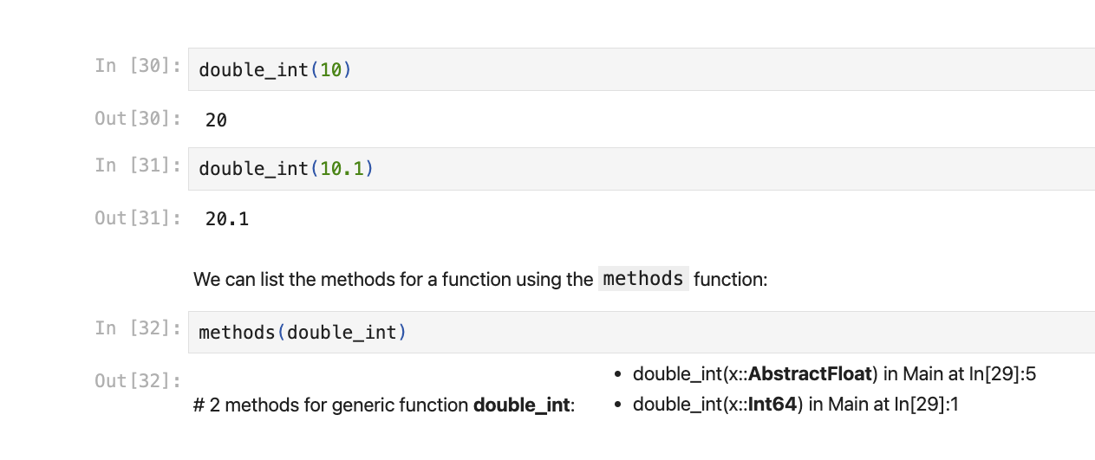
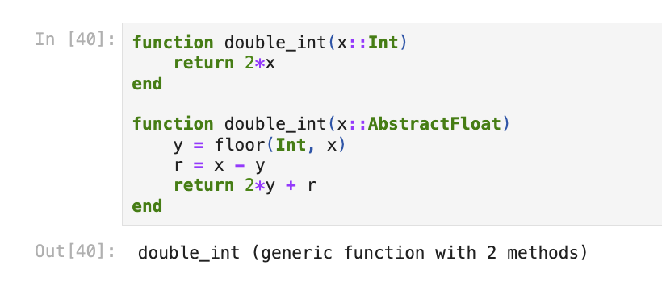
Multiple Dispatch => Situation-Dependent Code Generation
Let’s take a closer look at Multiple Dispatch:
A function’s implementation (method) is selected depending on the input types of the

Slide 6
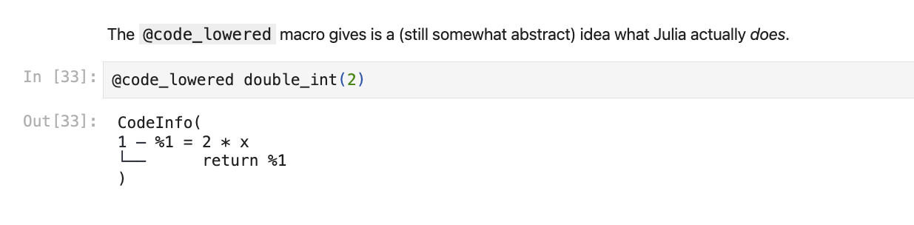
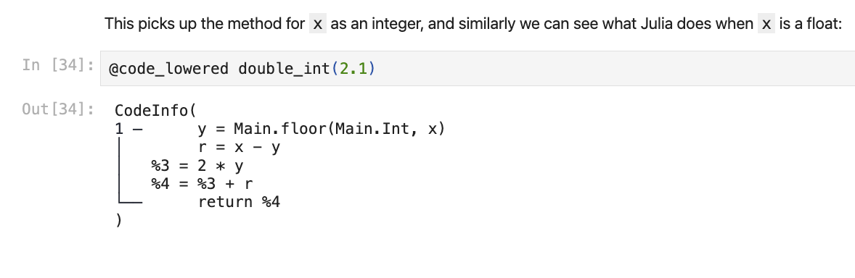
Multiple Dispatch => Situation-Dependent Code Generation
Let’s take a closer look at Multiple Dispatch:
A function’s implementation (method) is selected depending on the input types of the

Slide 7
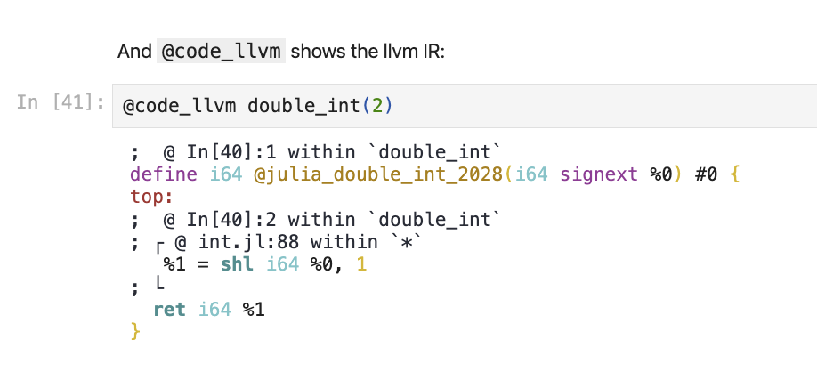
Multiple Dispatch => Situation-Dependent Code Generation
Let’s take a closer look at Multiple Dispatch:
Following dispatch, Typed IR is translated to LLVM IR
Julia is a REPL for LLVM:

Slide 8
Magic of Julia
Abstraction, Specialization, and Multiple Dispatch
Did I really need to move memory for that transpose?
Abstraction to obtain generic behavior: Encode behavior in the type domain: transpose(A::Matrix{Float64})::Transpose{Float64,Matrix{Float64}}
Specialization of functions to produce optimal code
Multiple-dispatch to select optimized behavior
rand(N, M) * rand(K, M)'
Matrix * Transpose{Matrix}
function mul!(C::Matrix{T}, A::Matrix{T}, tB::Transpose{<:Matrix{T}}, a, b) where {T<:BlasFloat}
gemm_wrapper!(C, 'N', 'T', A, B, MulAddMul(a, b))
end
No I did not! I know AB^{T} is the dot product of every row of A with every row of B .
compiles to
Slide shamelessly nicked from: Valentin Churavy

Slide 9

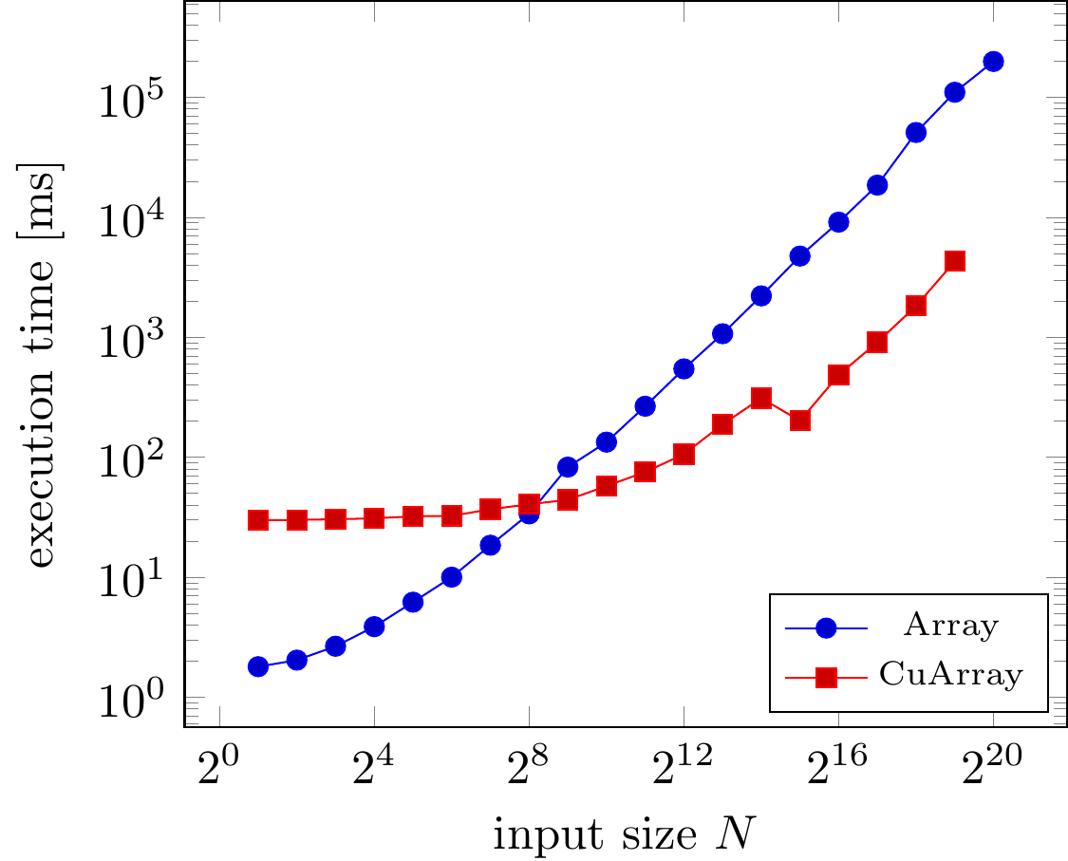
Array programming
Rapid software prototyping for heterogeneous and distributed platforms
Besard T., Churavy V., Edelman A., De Sutter B. (doi:10.1016/j.advengsoft.2019.02.002)
using LinearAlgebra
loss(w,b,x,y) = sum(abs2, y - (w*x .+ b)) / size(y,2) loss∇w(w, b, x, y) = ... lossdb(w, b, x, y) = ...
function train(w, b, x, y ; lr=.1) w -= lmul!(lr, loss∇w(w, b, x, y)) b -= lr * lossdb(w, b, x, y) return w, b end
n = 100; p = 10 x = randn(n,p)' y = sum(x[1:5,:]; dims=1) .+ randn(n)'*0.1 w = 0.0001*randn(1,p) b = 0.0
for i=1:50 w, b = train(w, b, x, y) end
x = CuArray(x)
y = CuArray(y)
w = CuArray(w)
Slide shamelessly nicked from: Valentin Churavy
Notes:
“random” code from Discourse: machine learning code
Loss + model, proximal gradient descent
Execute on the GPU: change input types
It even performs good!
Realistic, but best case scenario
Maps perfectly onto CuArrays’ strengths and weaknesses

Slide 10
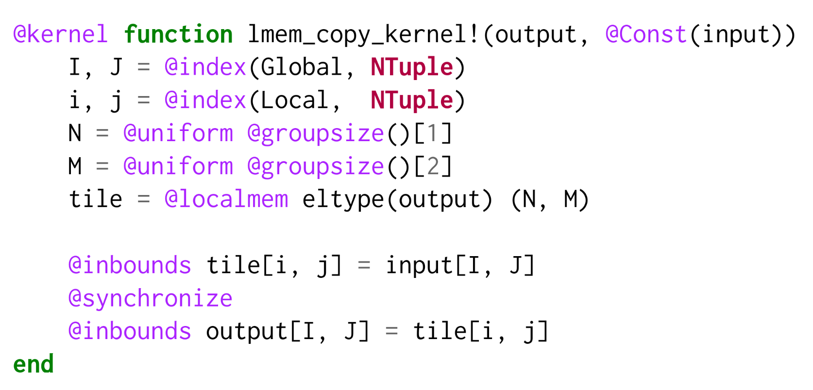
KernelAbstractions.jl
GPU-centric programming model
SIMT execution model
Multiple GPU backends
Implementation using macros and method overlay tables
GPU backends:
CUDA, AMDGPU, oneAPI, Metal
172 - 188 LOC
CPU execution as a fallback and for debugging
Widely adopted in the JuliaHPC and JuliaGPU ecosystem
Slide shamelessly nicked from: Valentin Churavy

Slide 11
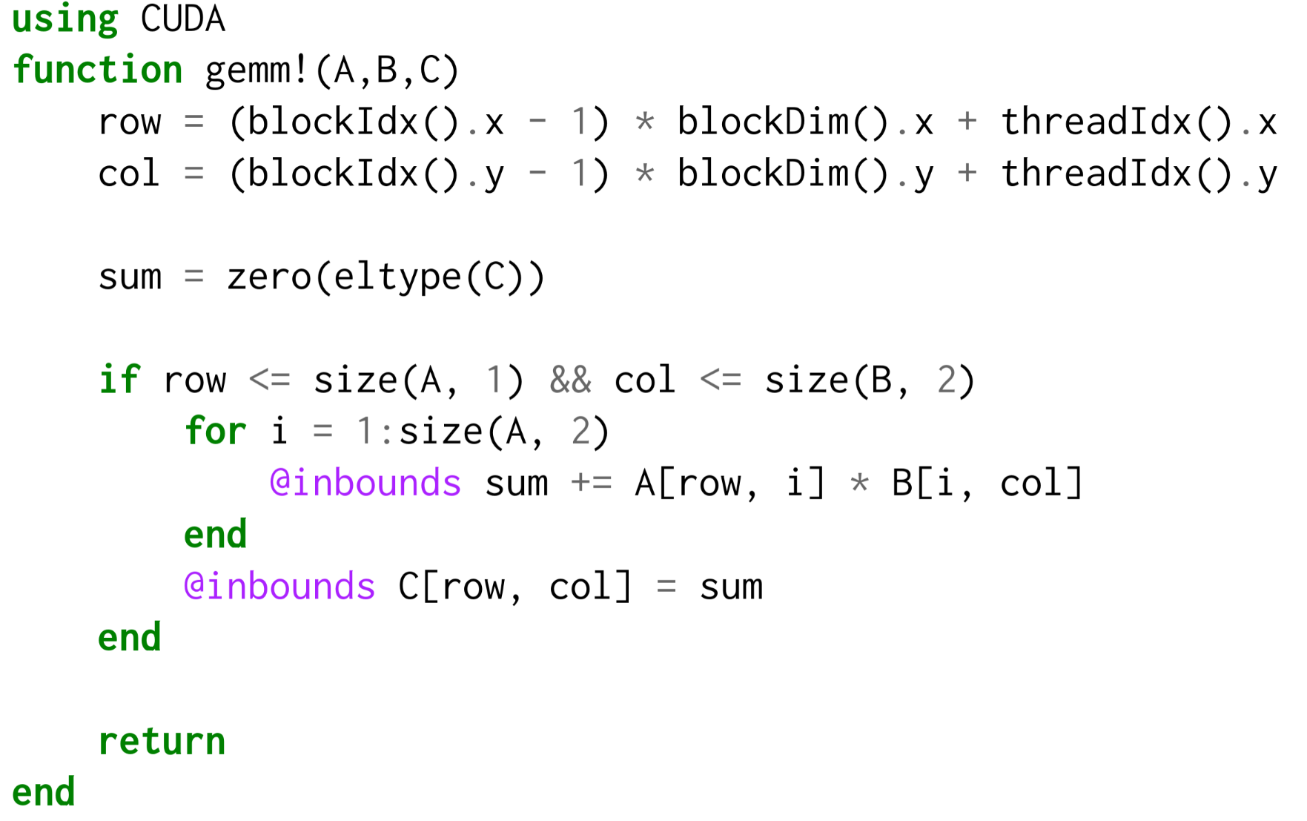
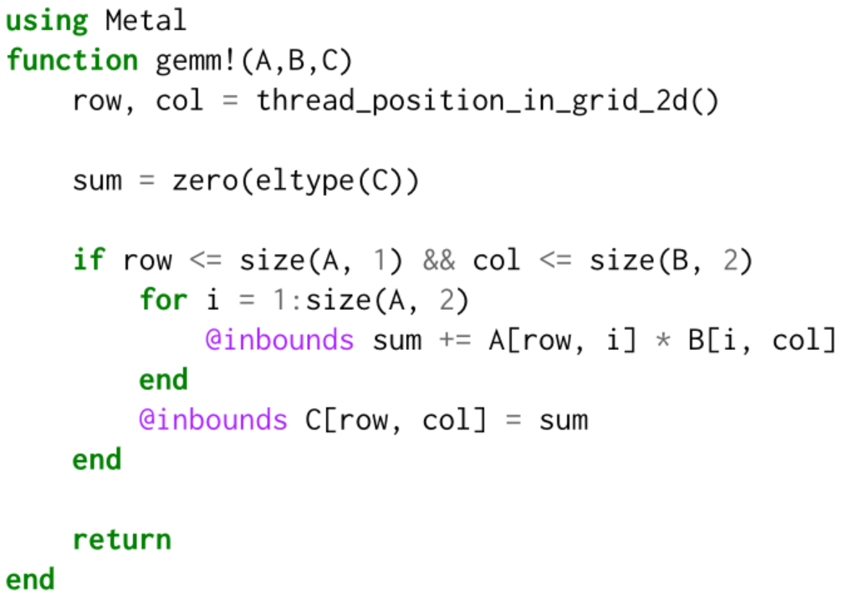
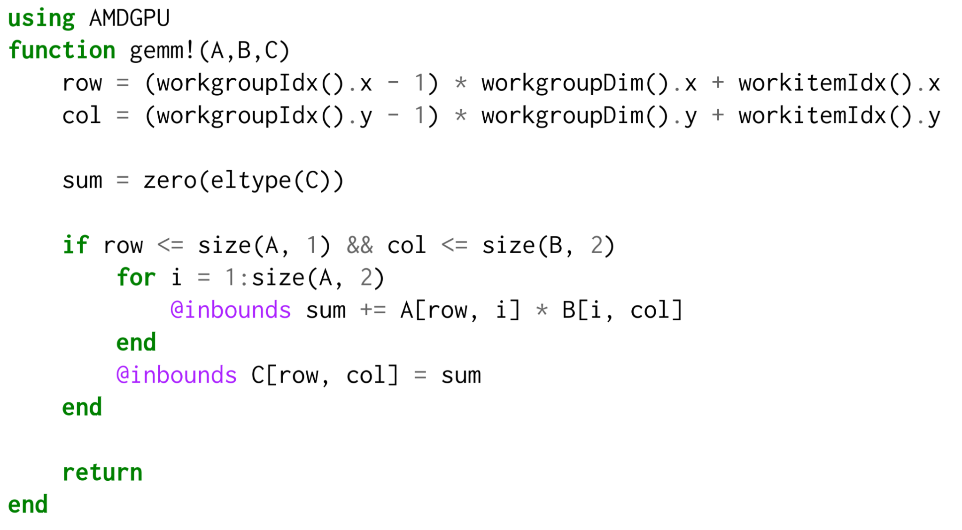
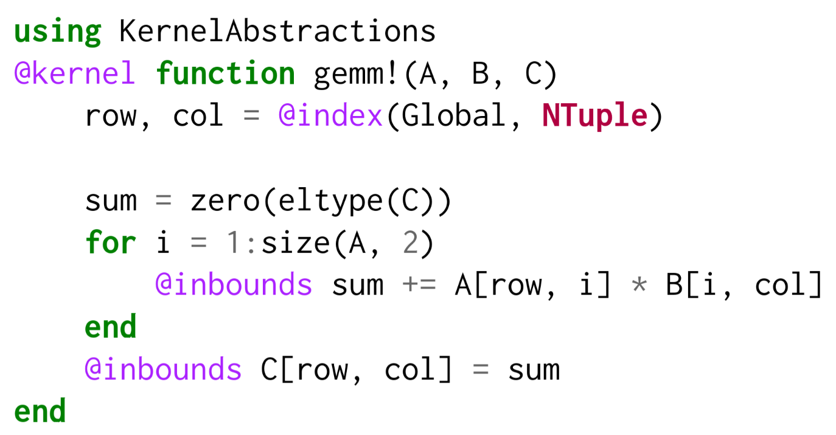
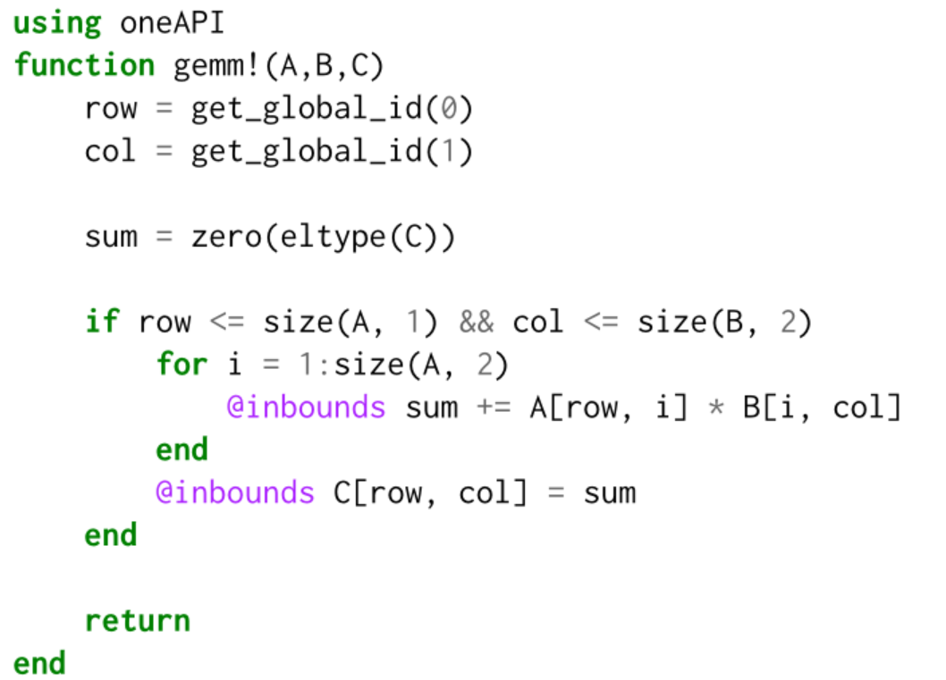
Julia’s xPU LLVM-backend also can generate Kernel code using CUDA.jl, AMDGPU.jl, or oneAPI.jl
KernelAbstractions.jl wraps all of these up into a single @kernel macro
Slide shamelessly adapted from: Valentin Churavy

Slide 12
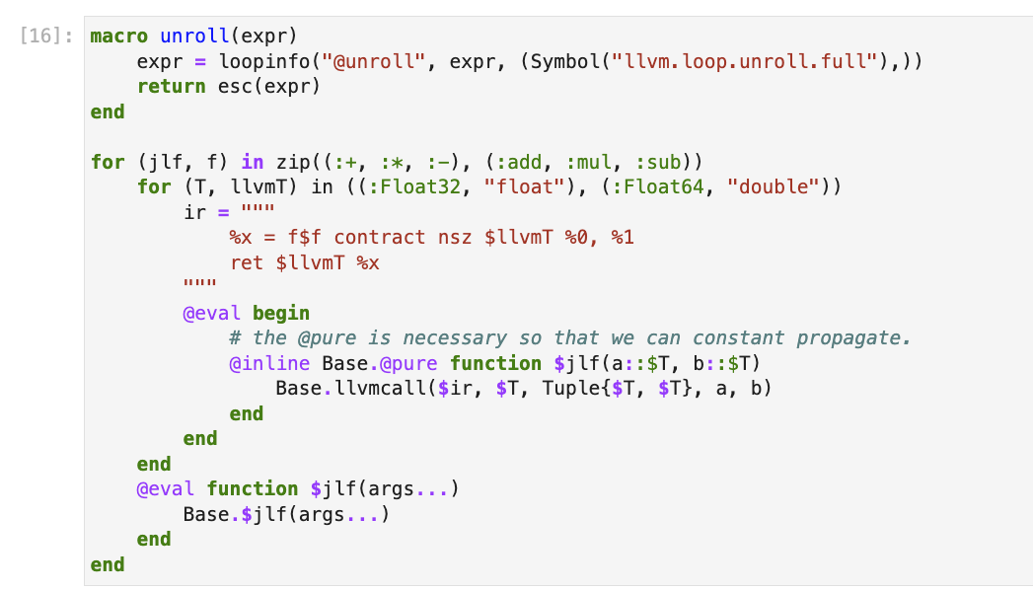
(advanced) LLVM + Julia
Julia provides interfaces to the LLVM backend.
Eg.:
loopinfo
llvmcall

